Slide 1
Task 2
Presentation

Slide 2
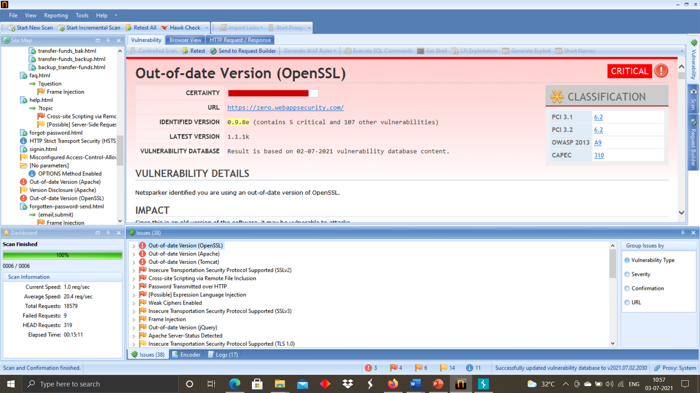
Report of NetSparker

Slide 3
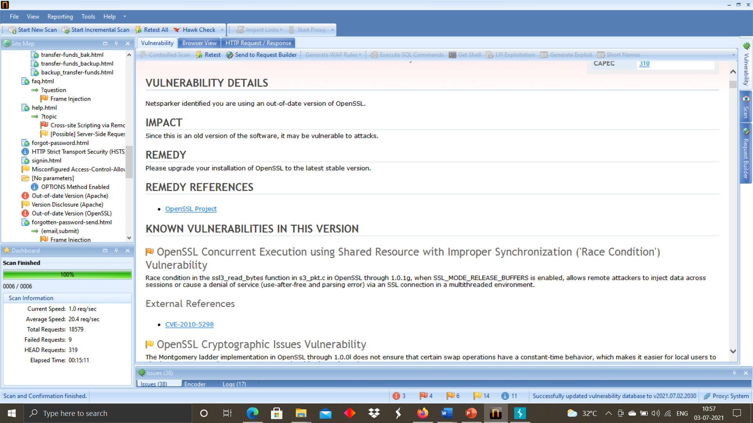

Slide 4
My report
Report of Task 2
Title – SQL Injection Vulnerability
Domain – zero.webappsecurity.com
Subdomain – zero.webappsecurity.com/bank/pay-bills.html
Description - One very critical vulnerability that I found in this application was the SQL Injection. On the zero.webappsecurity.com/bank/pay-bills.html in the Purchase Foreign Currency column there is an SQL Injection vulnerability present in the Currency input filed. When I intercepted the request using Burp Suite and the modified the request by adding a single quote to the currency, the page showed an error.

Slide 5
Severity – Very High.
Impact – The attacker can use this SQL Injection vulnerability to get hold of the database and its precious information.
Steps to reproduce →
Login to the account using the provided username and password.
Go to the Purchase Foreign currency column under the Pay bills column.
Select a country for currency. Do not press “Purchase” here.
Open Burp Suite and set it to intercept the requests.
Now press Purchase.
Send the intercepted request to the repeater.
In the Repeater we can see that currencyID is set to AUD
Here we just add a ‘ and send the request and render the response.
We can see the error, and the error even shows us the query being used to fetch the data.
Mitigation – To prevent the website from SQL injection, the backhand code should be improved to handle inputs such as ‘ , OR, AND, WHERE, etc.

Slide 6
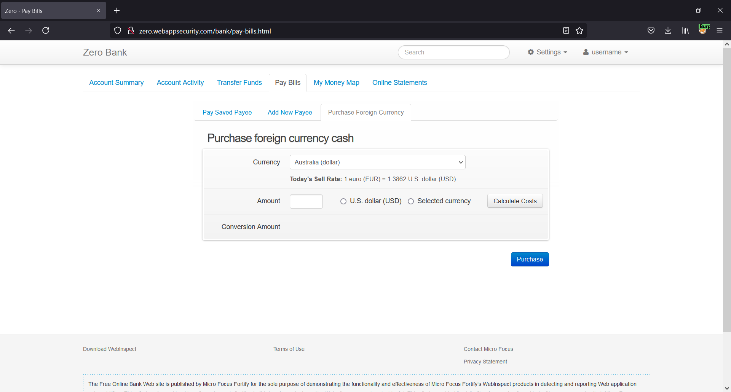

Slide 7
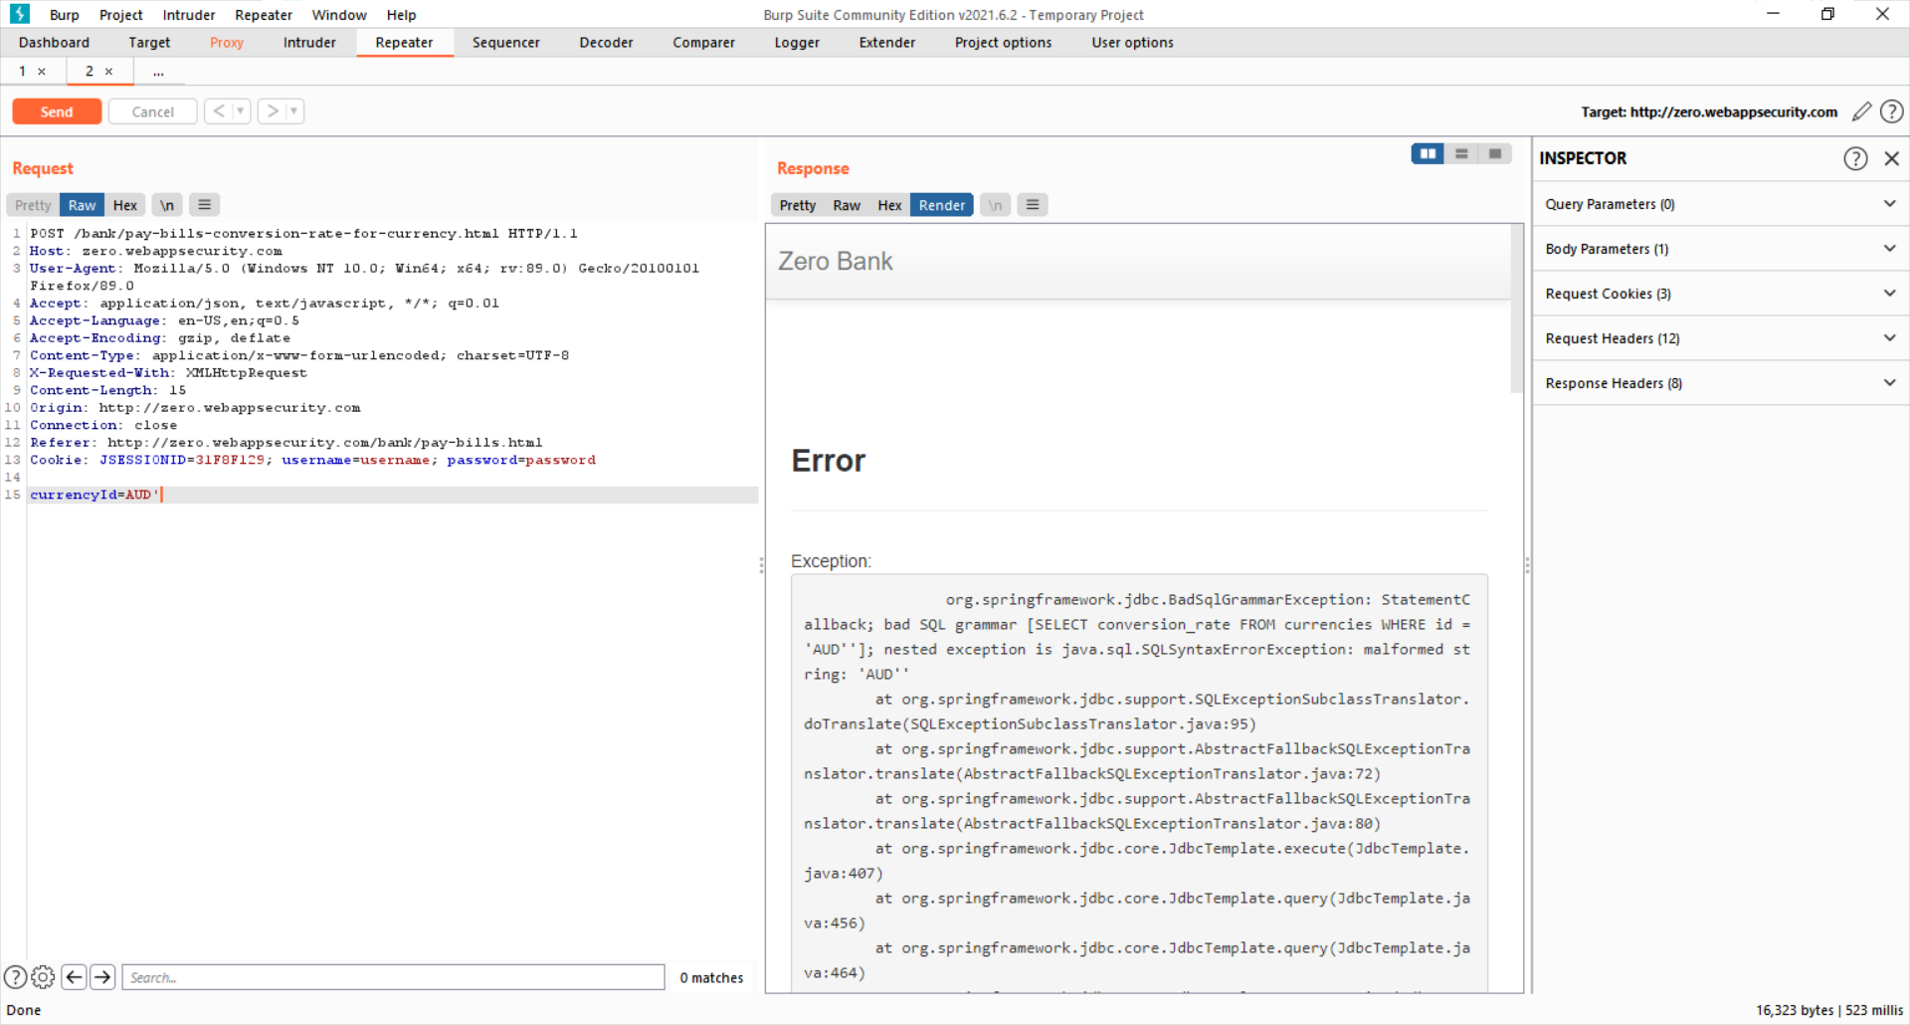

Slide 8
